Slide 1
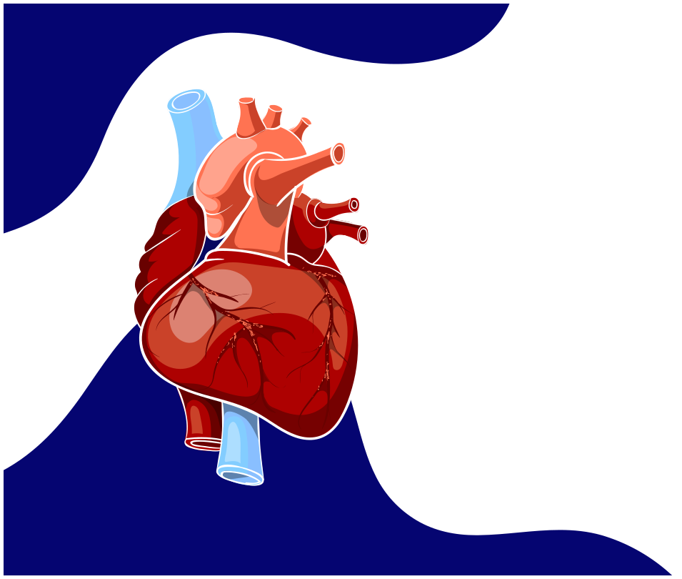

Detection of COVID-19 and Cardiovascular Diseases By ECG

Slide 2












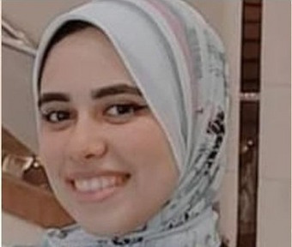

Our team
Yara Salman
David Hanna
Aya Eid
Hager Hamed
Huda Gamal
Semon Mamdouh
Jonathan Ehab
Under Supervision:
Dr. Mahmoud Bassiouni
Eng. Hayam Abdelbaset

Slide 3




OUTLINE
Introduction
Motivation
Problem statement Problem solutions
Related work
Data Set
implementation
Model Structure
Methodology
Technologies
Time plan

Slide 4

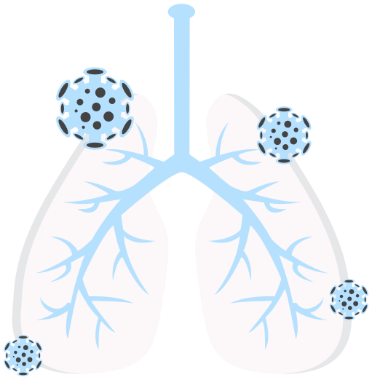
01
INTRODUCTION

Slide 5

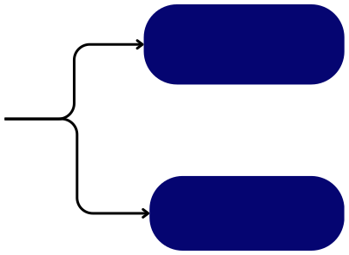
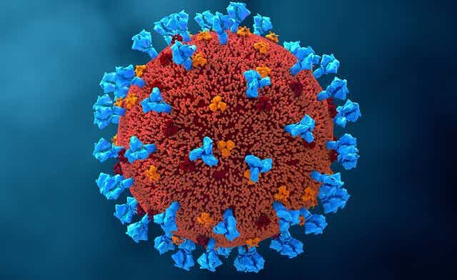
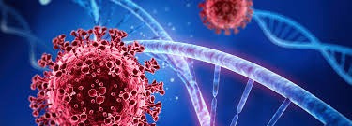
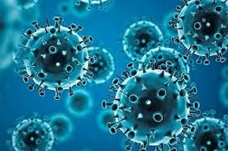
It was discovered recently that COVID_19 affects several organs in the human body, especially the cardiovascular system.
753 million
December 2019
March 2020
February 2023
people were infected with this disease
The covide19 first appeared in China
It was noted that the number of deaths worldwide due to this virus was significant
according to a report presented by the World Health Organization
6.8 million
deaths

Slide 6


It was estimated by the World Health Organization (WHO) in February 2023 that more than 17.9 million people are dying due to CVD
SOME OF THE DISEASES THAT CAN AFFECT THE HEART INCLUDE:
- Heart attack - Myocarditis (inflammation of the heart muscle) - Arrhythmias (heart rhythm disorders) - Cardiomyopathy (enlargement of the heart muscle)

Slide 7


02
Motivation

Slide 8

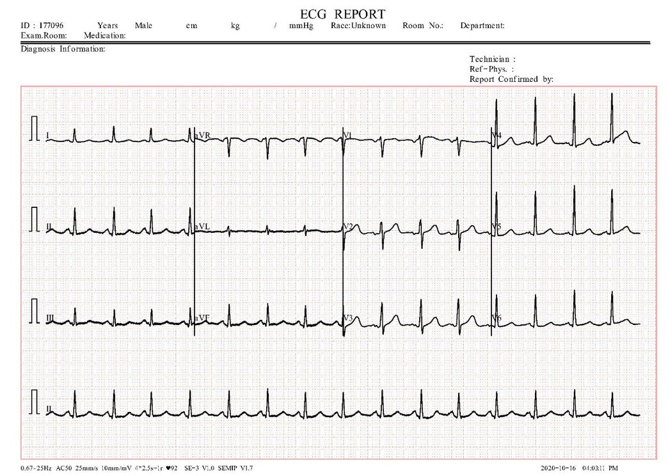

The motivation behind developing an application using ECG image for diagnosing heart diseases and COVID-19 is to enhance early diagnosis and provide effective healthcare.
This technology aids in identifying precise changes in heart activity, capturing early signs of heart diseases, and understanding the cardiac effects of the coronavirus.

Slide 9


This contributes to quicker treatment decisions, improving recovery chances, and enhancing preventive measures
The goal is to develop a simple and effective diagnostic tool using artificial intelligence technology, to assist doctors in diagnosing cases more quickly and accurately.

Slide 10
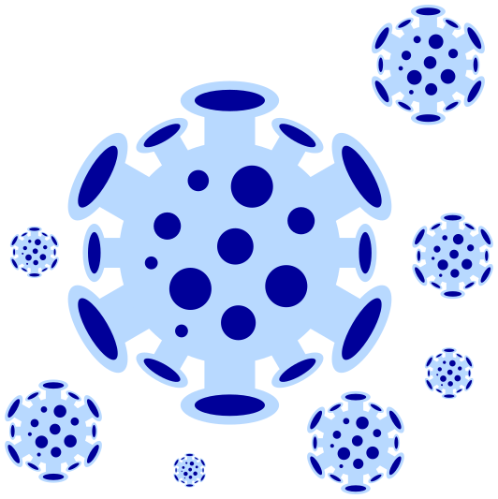


03
PROBLEM STATEMENT

Slide 11
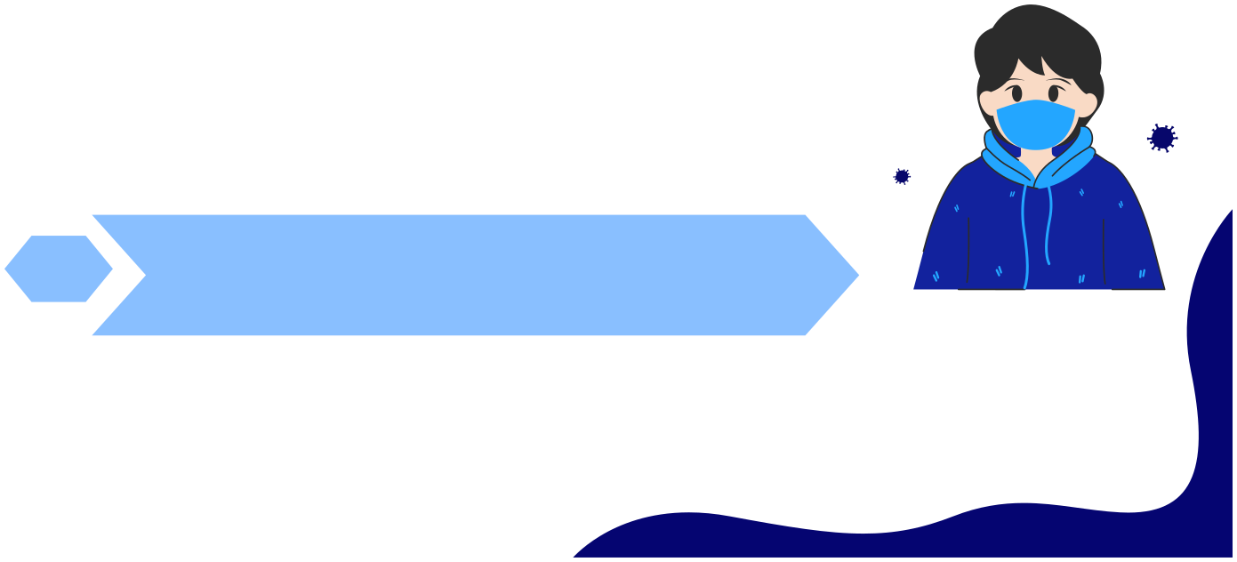
One of the problems users face when they need to diagnose whether they are infected with the coronavirus or have a heart condition is that they have two protocols to choose from.
The first protocol is PCR, which provides quick but less
01
accurate results.
02
The second protocol involves lung imaging, which is costly, time- consuming, and requires a doctor's intervention
Both protocols have their advantages, but they also have drawbacks. Therefore, it is important for us to develop a new protocol that assists users in diagnosis.

Slide 12

04
PROBLEM SOLUTION

Slide 13

SOLUTION
we developed a website that assists users in diagnosing these diseases by using ECG images
This helps guide treatment faster, improving chances of recovery and prevention
This method saves the user time, effort, and money, providing accurate and quick results

Slide 14
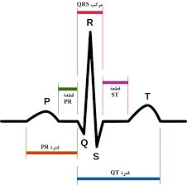



Electrocardiogram (ECG Signals)
(ECG) signals are considered one of the most important attributes for continuous monitoring of the human health.
The ECG signal consists of five main peaks which are the P, Q, R, S, and T.
The ECG technology depends on the
electrical impulses of the heart.

Slide 15

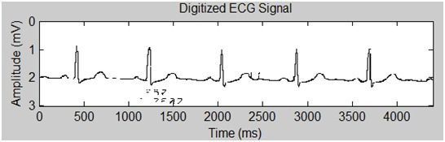

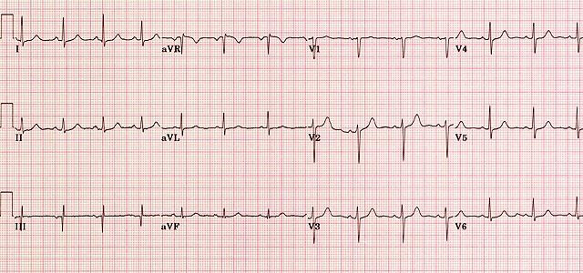
Electrocardiogram (ECG Image)
ECG can be represented in various shapes. One of these shapes is the digitized form of the ECG.
Another shape or form that describes the
ECG is the ECG graph or the ECG tracing.
ECG paper reports are printed in the form
of graph paper to achieve an accurate
interpretation

Slide 16




05
Related work

Slide 17

Authors
Methodology
Experiments
Results
Multi-Class Experiment COVID (250) vs MI (77) vs PMI (203) vs Abnormal (548) vs Normal (859)
Five-Fold Cross-validation A = 81.8 without augmentation A = 77.6 with augmentation
Anwar et al. 2021
EfficientB0 + Softmax
Multi-Class Experiment 5- class diagnosis COVID (250) vs MI (77) vs PMI (203) vs Abnormal (548) vs Normal (859)
Shahin et al. 2021
K-Fold Cross-validation A = 81.39
Vgg16 + Softmax
Multi-Class Experiments1st: COVID (250) vs MI (77) vs PMI (203) vs Abnormal (548) vs Normal (859)2nd: COVID (250) vs Normal (250) vs Abnormalities (250)Binary-Class Experiment3rd: COVID (250) vs Normal (250)
10-Fold cross-validation1st: A= 97.832nd: A = 97.363rd: A=
Rahman et al. 2022
DenseNet201 + Softmax
99.10
Fully connected features of 5 pre- trained models + DWT of the max- pooling features + 3 classifiers
1st: COVID (250) vs Normal (250) vs Abnormalities (250) Binary-Class Experiment 2nd: COVID (250) vs Normal (250)
10-Fold Cross-validation 1st: A = 91.73% 2st: A = 98.80% Using voting classifier
Attallah 2021

Slide 18
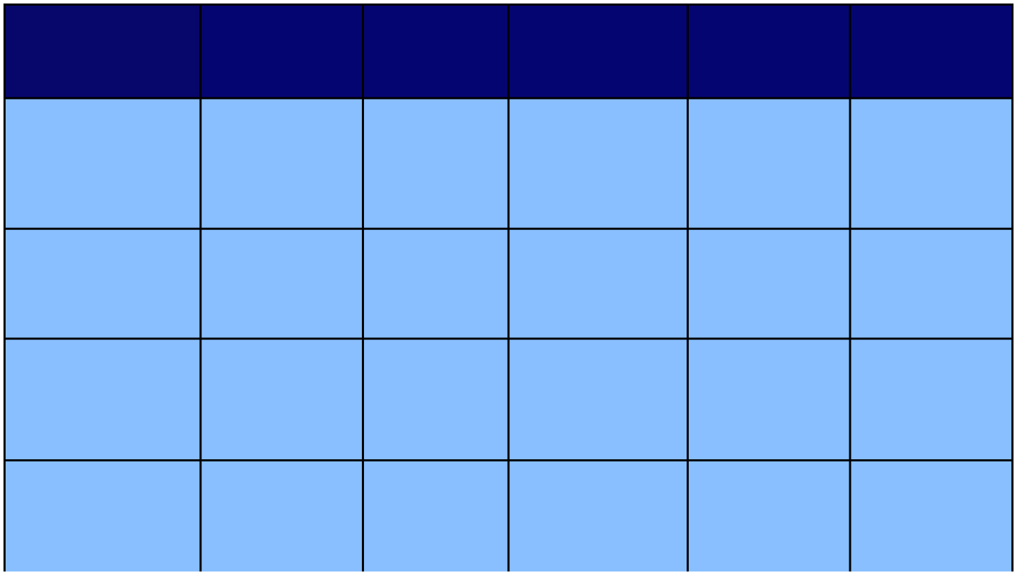
No classes and leads
Types of ECG classes
Number of ECG image Reports or Recorded Images
Authors
Methodology
Results
Hao et al. 2019
2 classes 12 ECG leads
Text detection of lead label + shallow neural network + depth fusion
Train and validation: 957 Test: 600 A= 94.73 % Sen = 96.41% Spec = 95.94% F1-Score = 93.79%
Normal vs MI
1557 ECG image reports
Ferreira et al.
2 classes 12 ECG leads
Normal vs Abnormal
100673 image samples
LBP + MLP
A = 96.18%
2019
Normal Abnrmal Mycrocardial History of Microcardial Covid_19
Mask and CNN Modal (inception_v3)
Train=97.5% Test=97.2% Validation=97.7%
OurTeam
5 Class
8350 Images
Gliner et al. 2020
41830 Digital and Image leads
Training and validation = 86% Testing = 14% A = 88%
8-classes 12- ECG leads
AF, I-AVB, LBBB, RBBB, PAC, PVC, STD, and STE
CNN-ima and CNN-dig

Slide 19

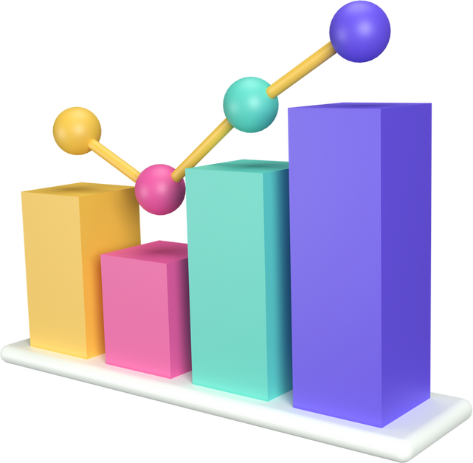
06
DATASET

Slide 20


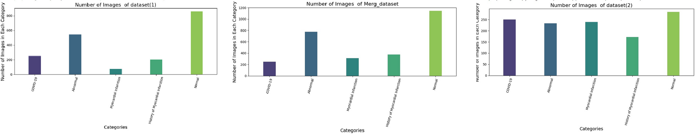
Dataset Information
Our dataset consists of five types of ECG (Electrocardiogram) images.
Dataset(1)
Merg Dataset
Dataset(2)
Total Number of ECG Images is 1932
Total Number of ECG Images is 2860
Total Number of ECG Images is 1178
This dataset consists of ECG images collected from two countries China and Pakistan .

Slide 21

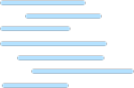
07
IMPLEMENTATION

Slide 22
Image preprocessing
is the first step in implementing the model, where we prepare the data by applying image filters to improve the quality and suitability of the images for the deep
learning algorithm.

Slide 23





Image preprocessing
Remove
Rescale
Background
Remove
Resize
Data
Noise
Augmentation

Slide 24

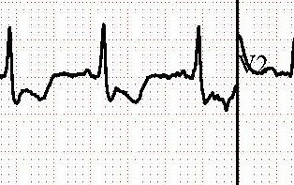

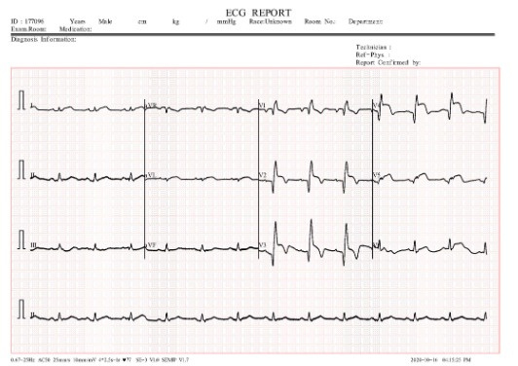
Image Preprocessing
1-Remove
Noise
Removing noise from images is a crucial step in image processing to improve the overall quality and clarity of an image
Noise in images refers to random variations or unwanted
disturbances in pixel values, often introduced during image acquisition , transmission, or processing.
To enhance the accuracy of our image processing, we must address the noise present in the header and footer. This noise can take the form of text, logos, or other visual elements that are not part of the main image content.

Slide 25




TECHNOLOGY USED FOR REMOVING NOISE
we use Bilateral Filtering to remove noise
03
02
It considers both spatial closeness and intensity simil arity.
01
the image
while
preserving
edges.
is a non-
linear method
that smoothens

Slide 26
Image Preprocessing
2-Remove
Background
This process is essential to enhance the visibility of key information with in ECG images, improve analysis accuracy, and facilitate the classification of patterns present in ECG. Removing the background is necessary to enhance the performance of models.
Technology used to Removing background
1- Segmentation
is attempts to partition the pixels of an image into groups that
strongly correlate with the objects in an image Then it's easy
to extract it from a background

Slide 27

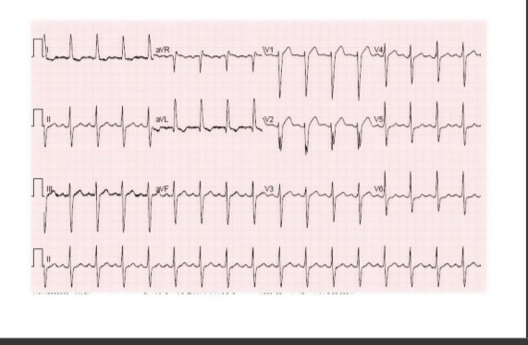
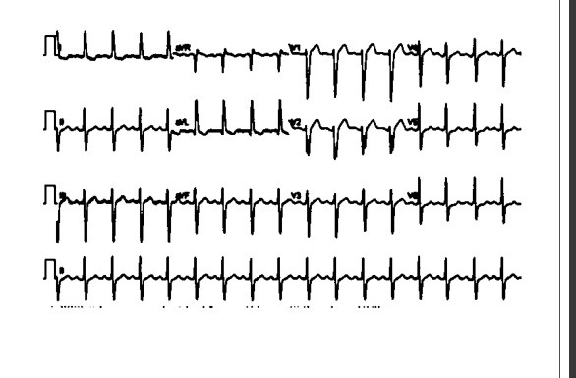
In the process of
segmentation, type of thresholds are used
binary with Otsu’s
Before
After

Slide 28



To improve the accuracy, we used a mask to remove the background.
2- mask
is a binary image used to identify specific parts ofanother image. The values in the mask are either 0 (black) or 255 (white), where white represents the areas we want to keep or process, and black represents the areas we want to ignore or exclude.

Slide 29






steps to create the mask
01
02
03
Define the white color range:
Improve the mask:
Create a mask:
A mask is created using the cv2.inRange function, which identifies the white parts of the image.
We use morphological opening to remove small white points from the mask for better results. A structuring element in the shape of an ellipse with a size of 3x3 pixels is used.
We define the range of white color using NumPy arrays. Here, we consider colors between [50, 50, 50] and [255, 255, 255] as white.
04
05
06
Invert the mask:
Create a white background:
Apply the mask to the original image:
The inverted mask is applied
to the original image, keeping
only the non-white parts.
The mask is inverted so that non-white areas are retained.
A completely white image of the same size as the original is created.

Slide 30




steps to create the mask
07
08
Apply the mask to the white background:
Invert the mask again
The mask is inverted (again) and applied to the white background, turning the white areas of the original image into white.
09
Combine the results:
The preserved parts of the original image and the white background are combined using the bitwise "or" operation.
10
Invert the mask to save the results: The final image (final.jpg) and the mask
(mask.jpg) are saved to disk.

Slide 31
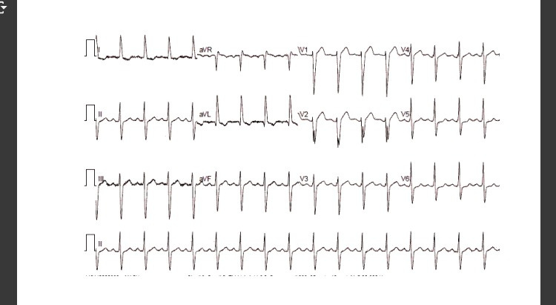
Before
After

Slide 32



Image Preprocessing
3. Resizing
Image resizing adjusts the dimensions of an image for consistency and efficiency in machine learning models, enhancing performance and resource management.
4. Rescaling
Rescaling is adjusting data to a common scale, crucial for equal feature influence in machine learning. It enhances algorithm performance and ensures fair analysis.

Slide 33

Image Preprocessing
5.Data Augmentation
Deep learning technique requires much more training data than other machine learning approaches. In case where the data consists of images and not much data is available, image augmentation can be applied to increase the number of training examples and to avoid over fitting.

Slide 34
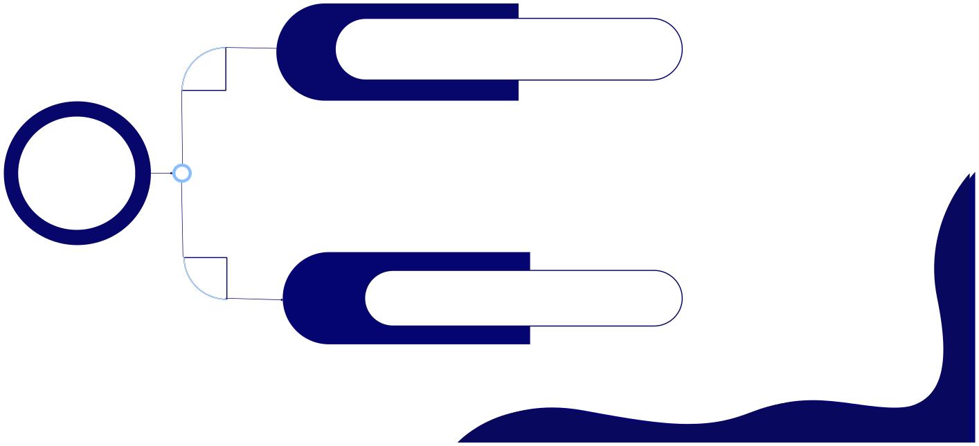

Techniques for Data Augmentation:
rotation_range=9 zoom_range=0.2 brightness_range=(0.5, 1.5) horizontal_flip=True vertical_flip=True shear_range=0.085 width_shift_range=0.085 height_shift_range=0.085
Image Data Generator Based On Geometric Transformations
Two ways
GAN-based Augmentation: Generative Adversarial Networks (GANs) generate synthetic data that closely resemble real samples, effectively expanding the dataset.
Deep learning advanced
We don't have powerful devices on our team to support GAN technology,

Slide 35
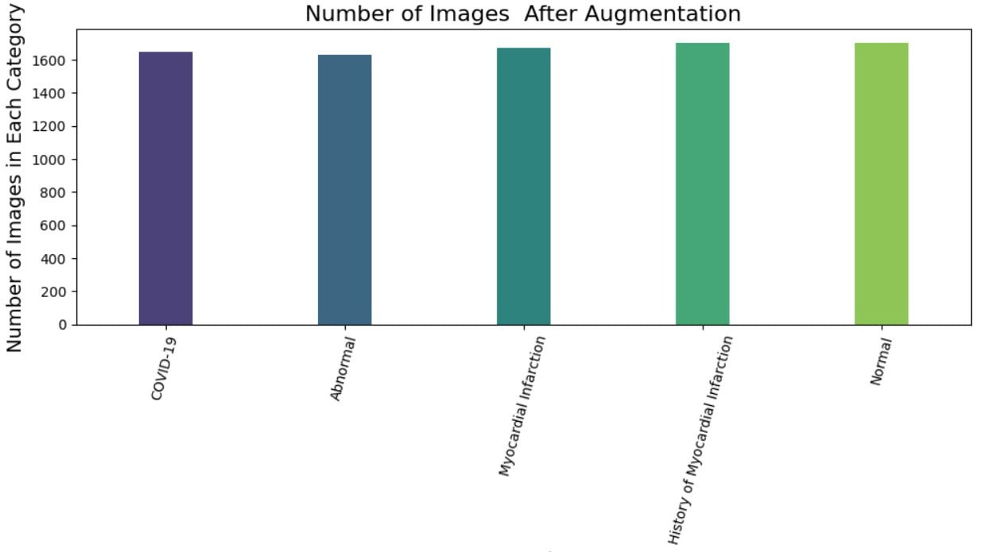
Total Number of ECG Images is 8350

Slide 36

09
Model Structure

Slide 37
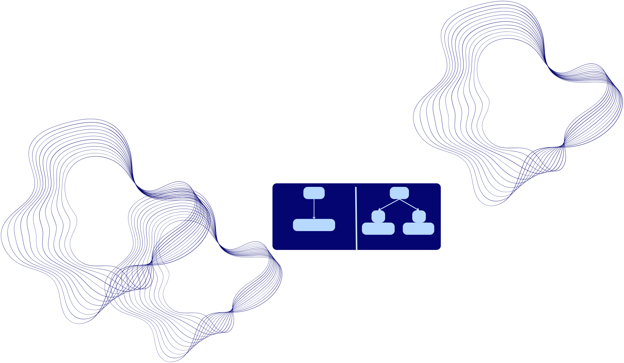
WE DIVIDED THE DATA INTO THREE DATA SETS:
70%
30%
15%
15%
TRAIN
TEST
VALIDATION

Slide 38
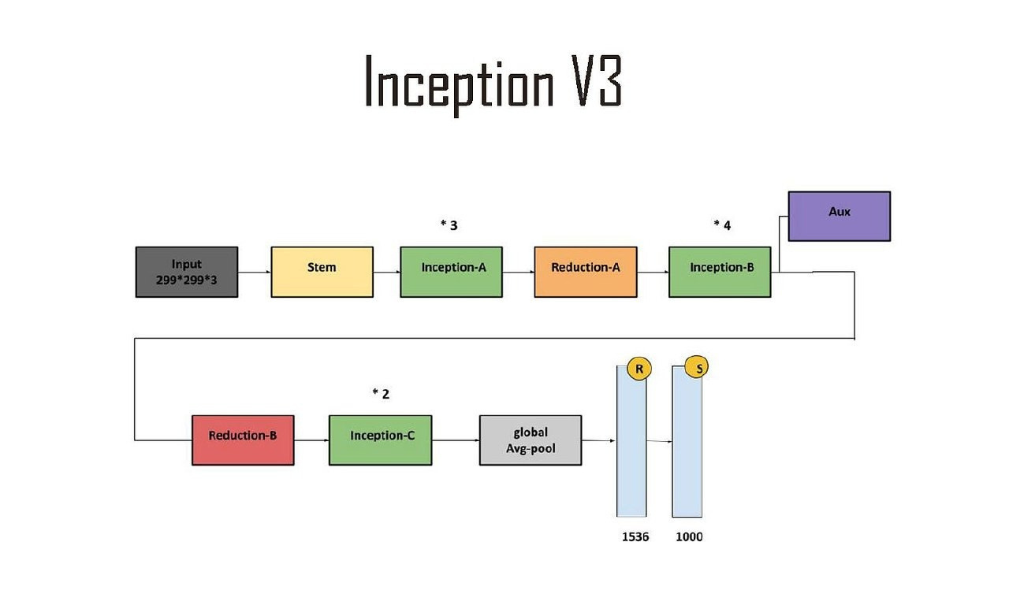
Utilization Model
the Inception V3 network, which is an advanced convolutional neural network (CNN) designed for image processing

Slide 39
Model Structure
input :
stem :
inception A:
The initial part of the network processes the input data to prepare it for the subsequent stages.
A series of Inception modules of type A, which combine different convolutional operations (such as (1*1), (3 * 3), and 5 * 5)) to capture various features from the data.
The input is an image with dimensions (299 * 299 * 3).
- It includes multiple
convolutional and pooling layers.
Reduction-A:
Inception-B:
Auxiliary Classifier:
A series of Inception modules of type B, which include various convolutional operations to deepen the network and increase the complexity of the features learned.
An auxiliary classifier used to provide additional training signals, helping to improve gradient flow during training. - It consists of several convolutional and pooling layers, followed by a classification layer.
A dimension reduction module of type A, aimed at reducing the spatial dimensions (height and width) while increasing the depth (number of channels)

Slide 40
Reduction-B:
A dimension reduction module of type B, further reducing the spatial dimensions and deepening the network
Inception-C:
Global Average Pooling:
A series of Inception modules of type C, continuing to apply various convolutional operations to capture more features.
A global average pooling layer, applied to reduce the spatial dimensions to 1, taking the average across each feature map. - Outputs a number of features equal to the number of channels.
Fully Connected Layers:
Dropout layer :
use to remove neurons that have noise
Last fully connected layer:
Fully connected layers applied after global average pooling.
use 5 neurons to make classification and use softmax classifier
- Include a final layer that outputs
probabilities for each class (usually 1000 classes for image classification in ImageNet)

Slide 41


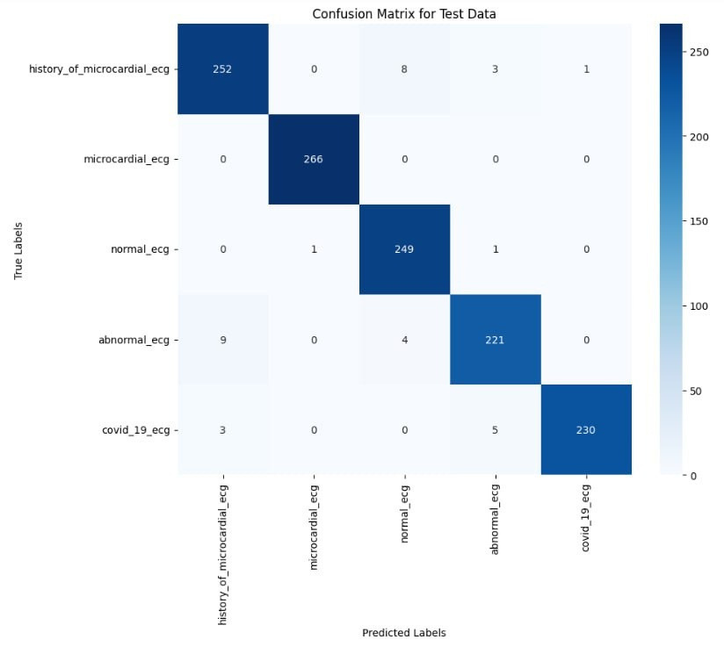
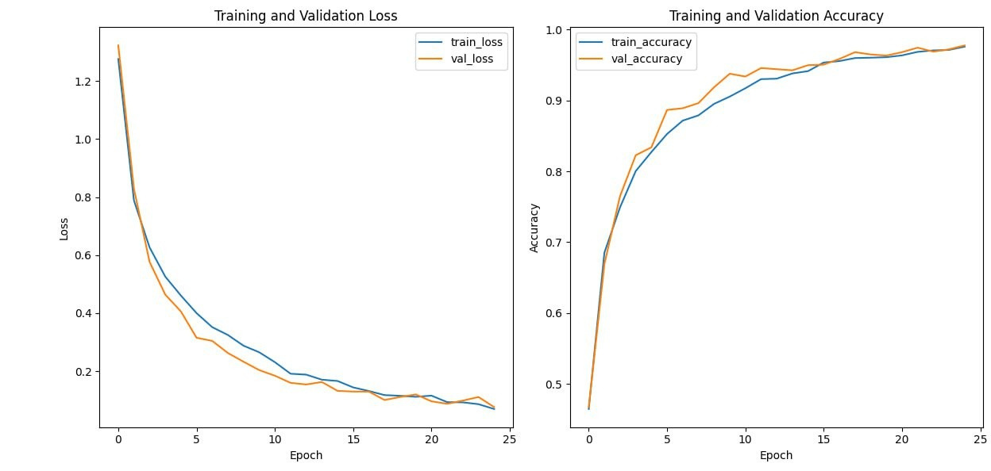
Confusion Matrix
Loss & accuracy

Slide 42





Comprsion between different models
Resenet_50
Inception V3
Vgg_19
Accuracy of train : 96%
Accuracy of test:95%
Accuracy of train : 95%
Accuracy of train : 97.5%
Accuracy of test: 97.2%
Accuracy of test:94%
Loss of train:0.24
Loss of test:0.27
Loss of train:0.13
Loss of test:0.14
Loss of train:0.06
Loss of test:0.09

Slide 43



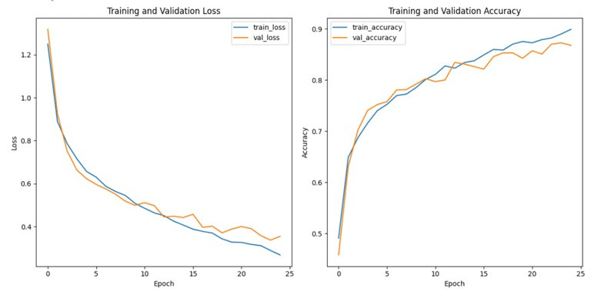
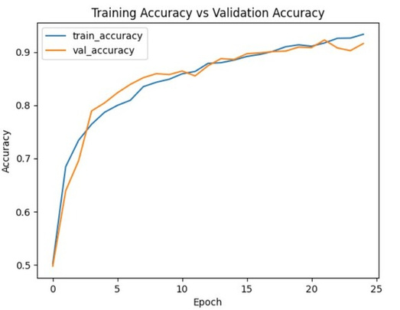
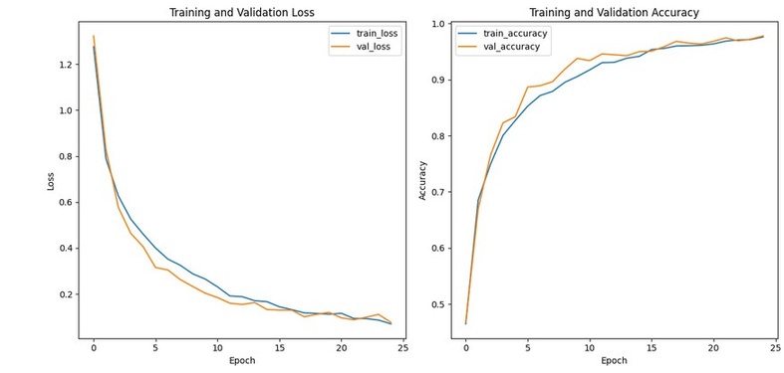
The comparison between two dataset
DataSet.1
MERG_DataSet
DataSet.2
Train Accuracy:89% Test Accuracy:87%
Train Accuracy:93% Test Accuracy:91%
Train Accuracy:97.5% Test Accuracy:97.2%

Slide 44
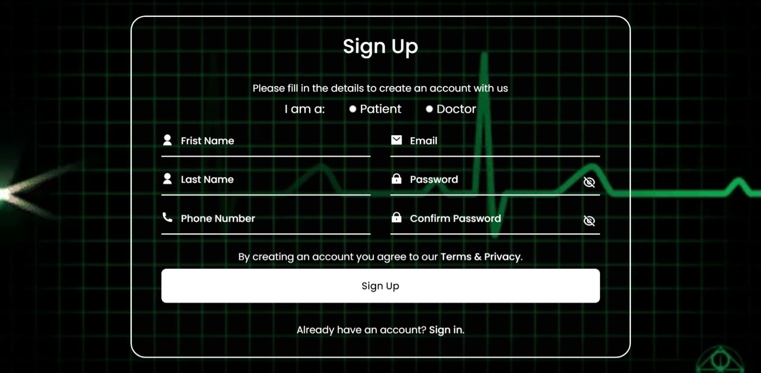
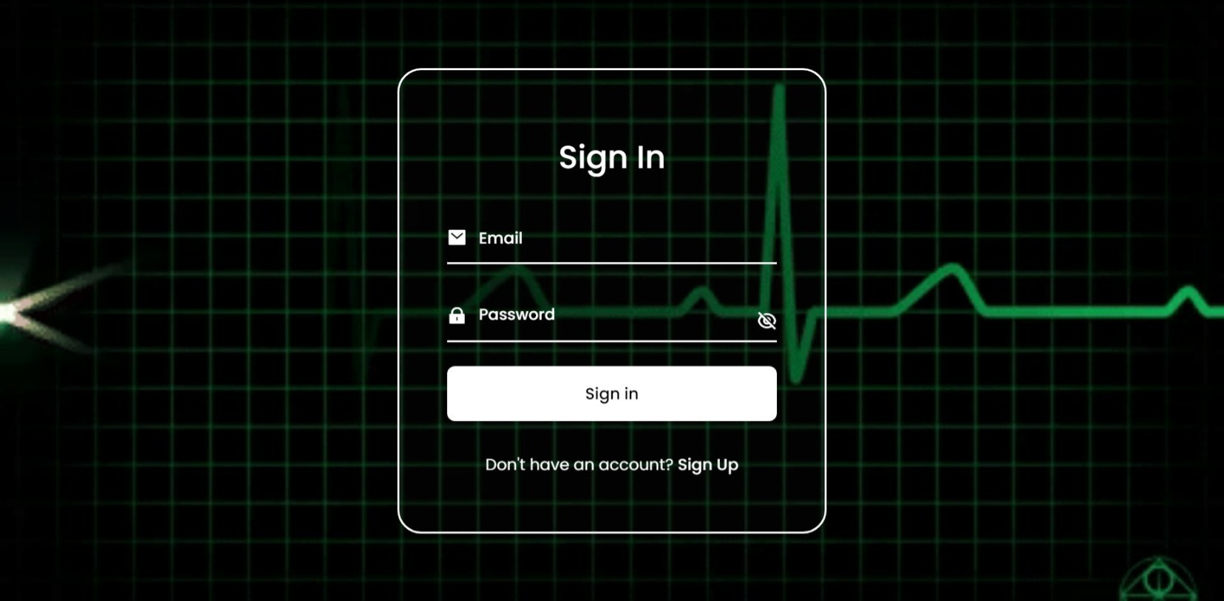
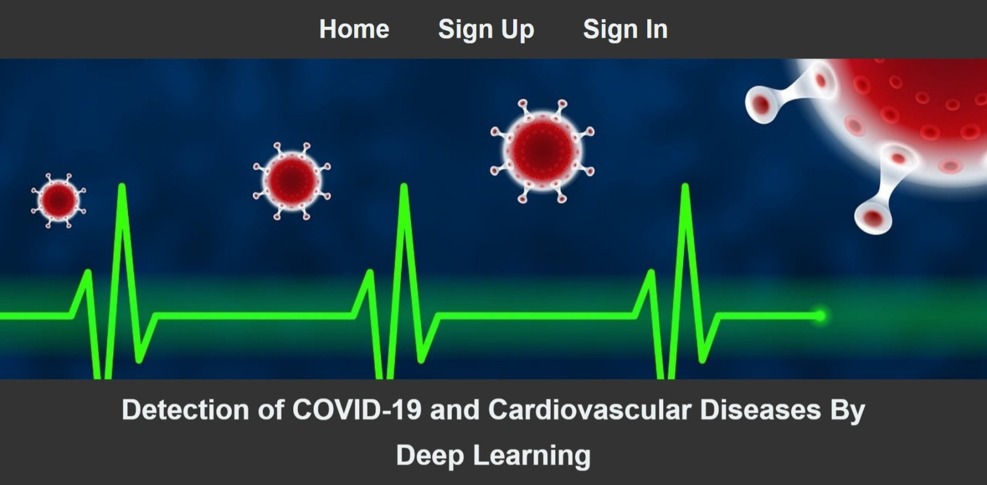
Sign Up or SIign In

Slide 45
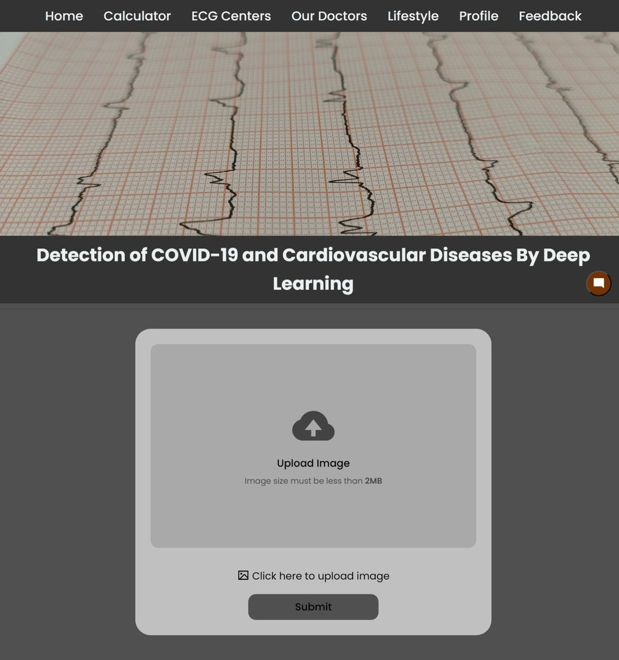
Upload ECG-Image

Slide 46
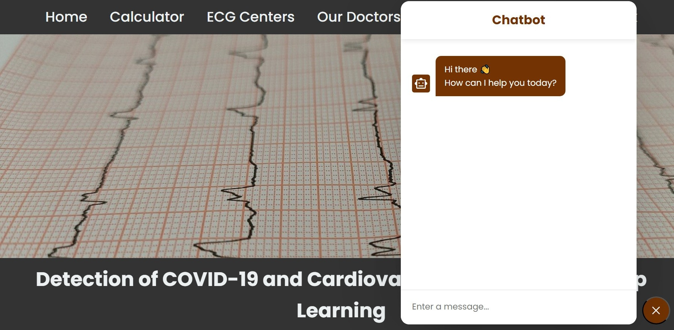
Chatbot for any Patient’s Question

Slide 47

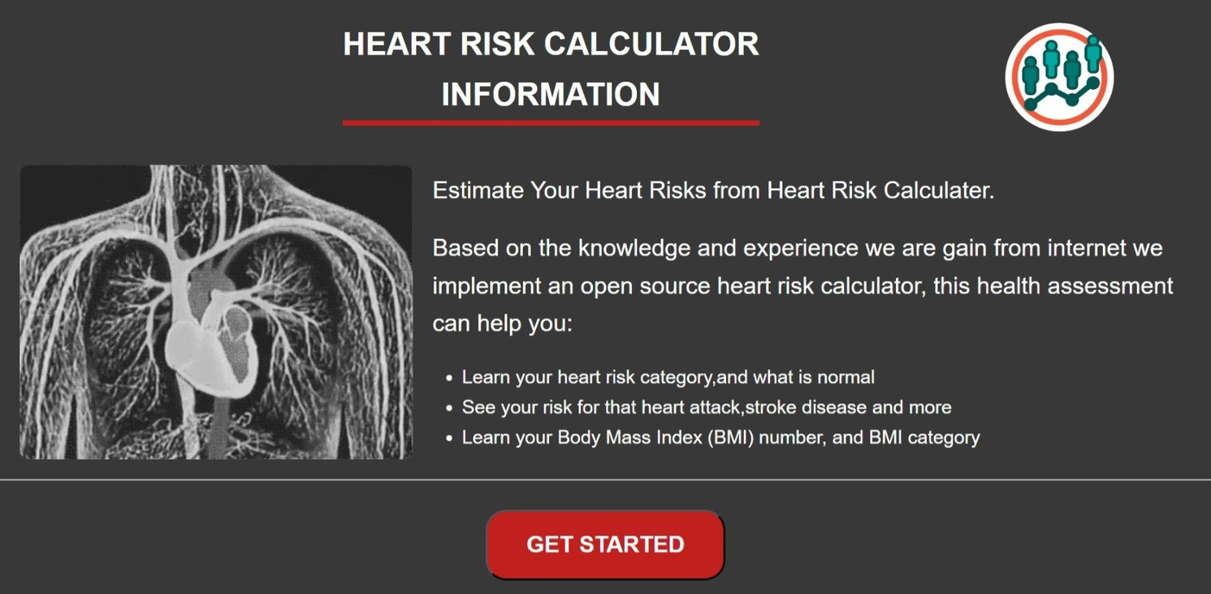
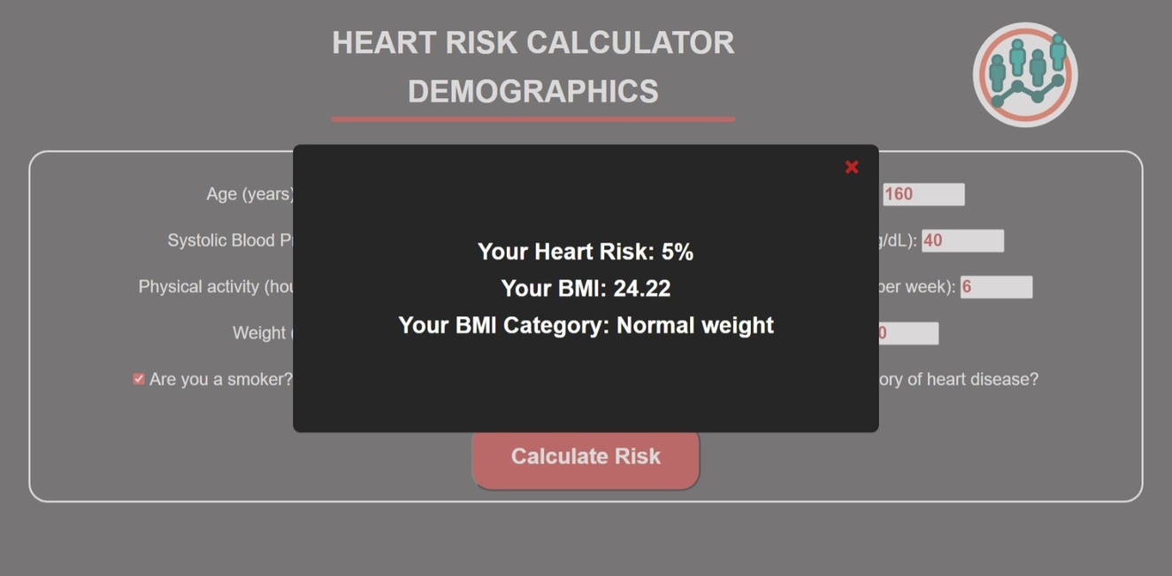

Risk Calculator

Slide 48

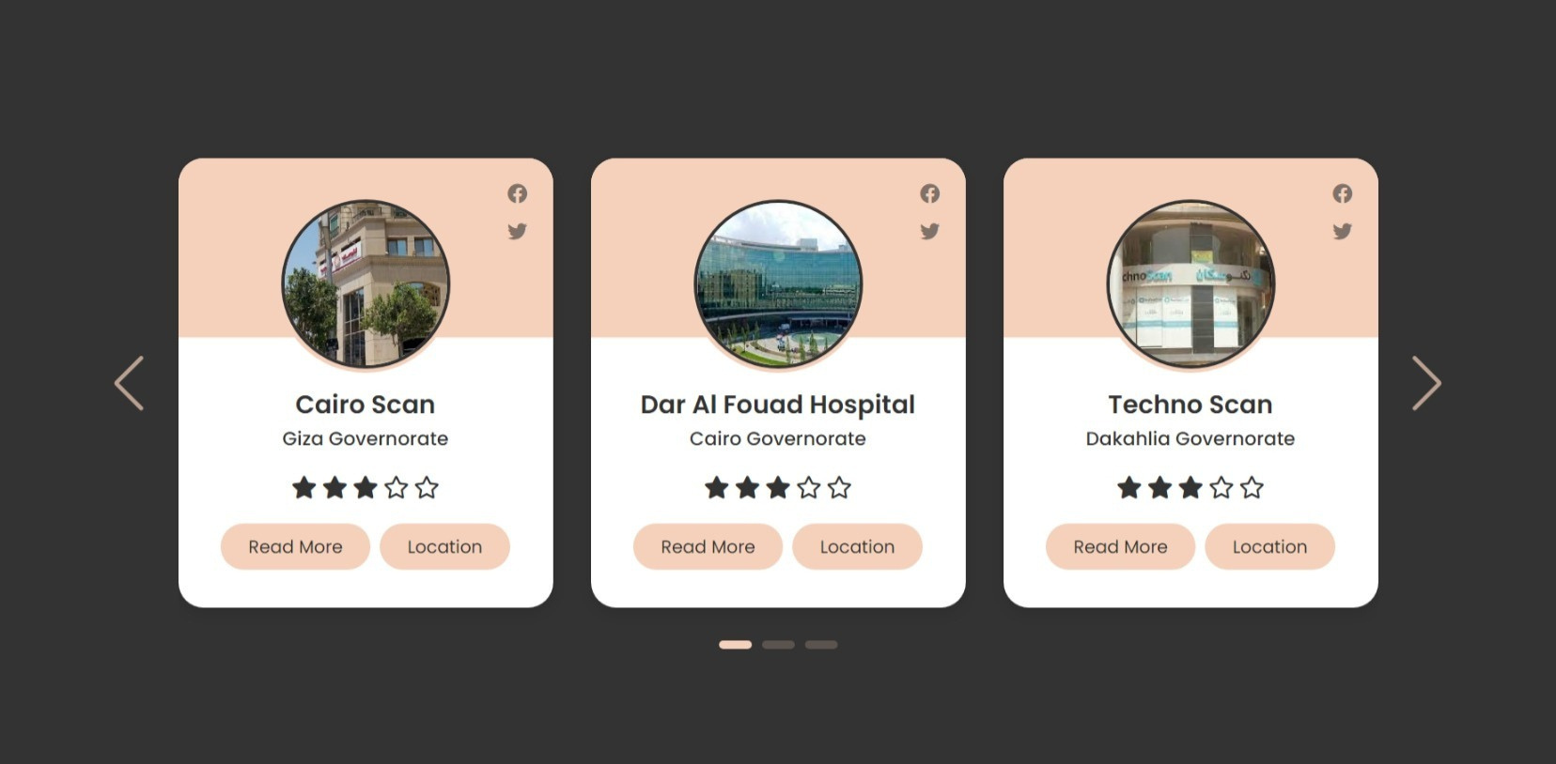
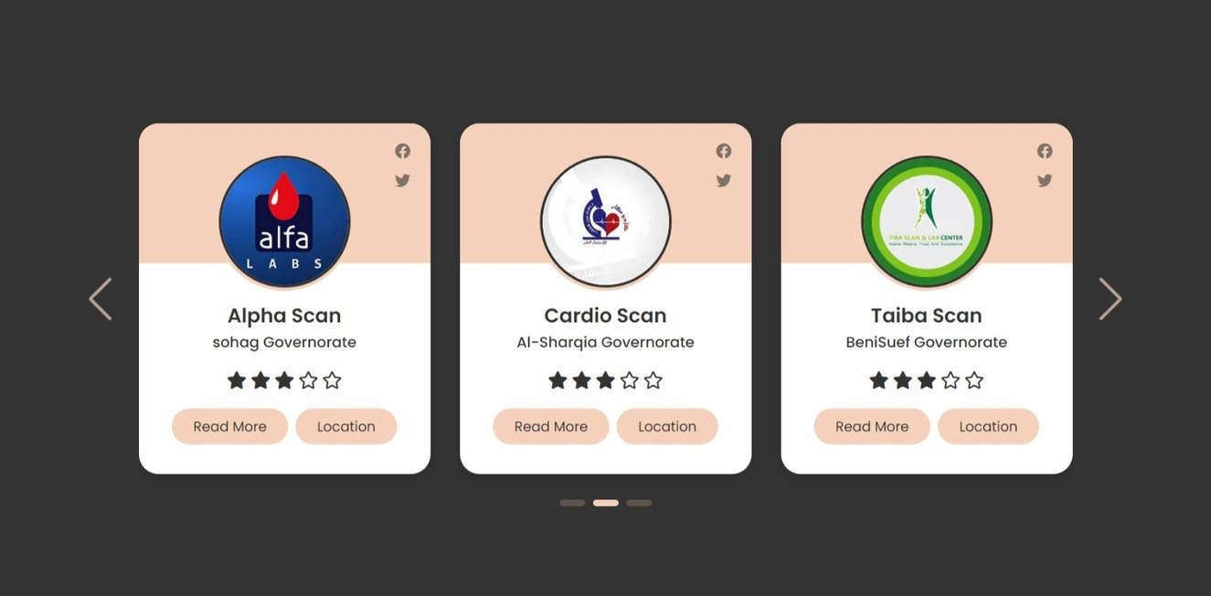

ECG-Image Centers

Slide 49



Our Doctors

Slide 50
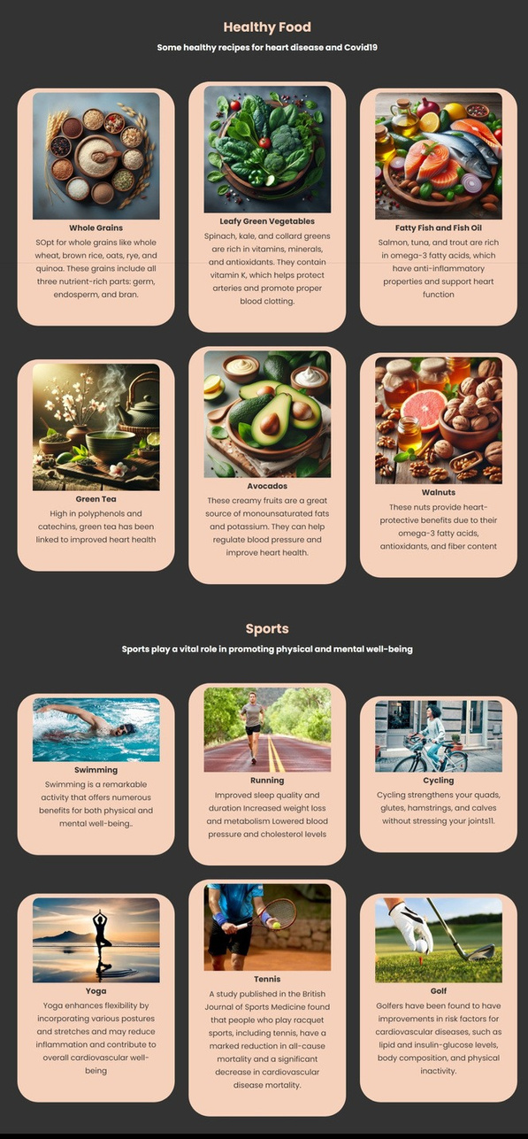
Lifestyle Page contains recommended
Healthy Food and Sports
for Heart Patients and
Covid-19 Patients

Slide 51
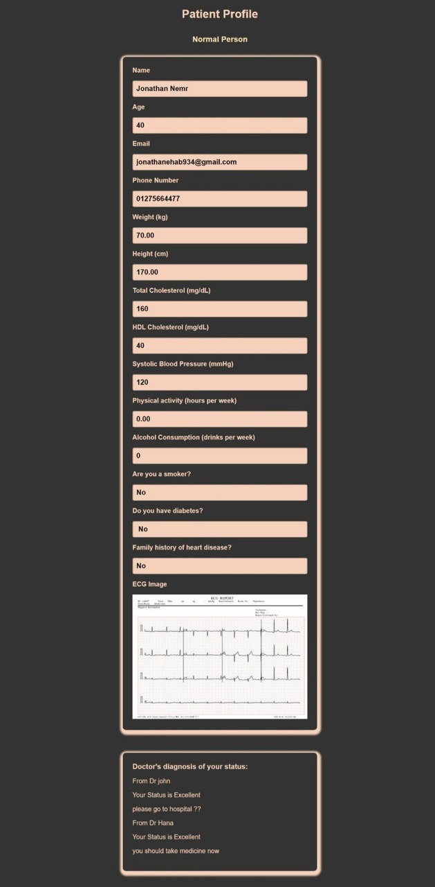
Patient Profile contains all data that
the patient entered
on the website

Slide 52
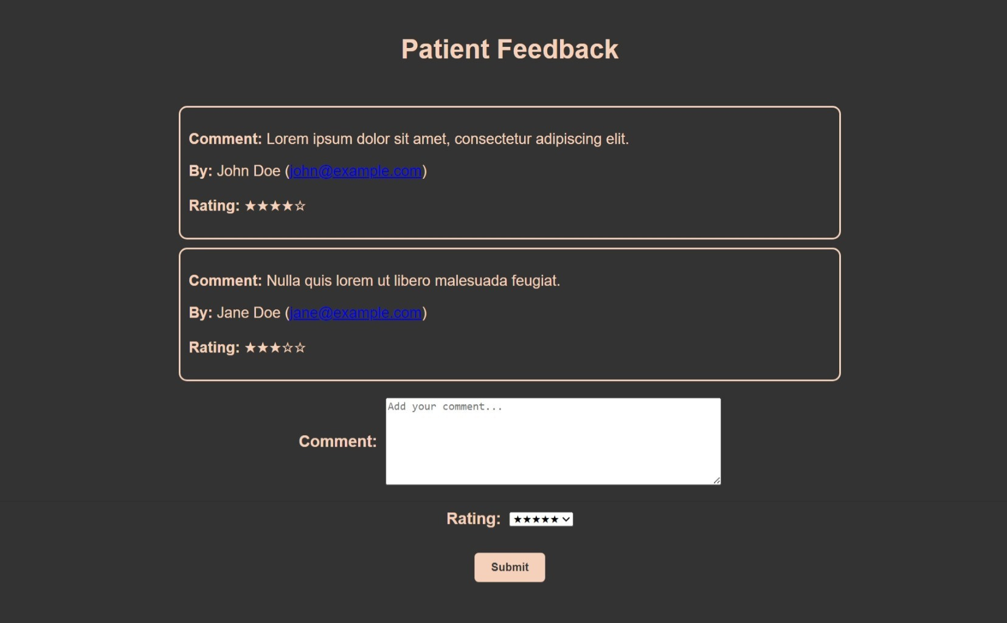
Comment and Evaluation of Patients for Website

Slide 53
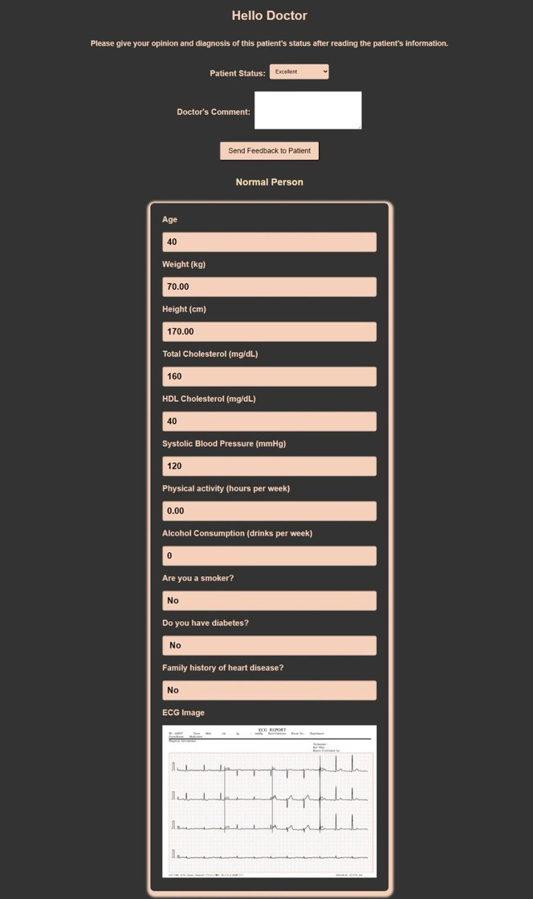
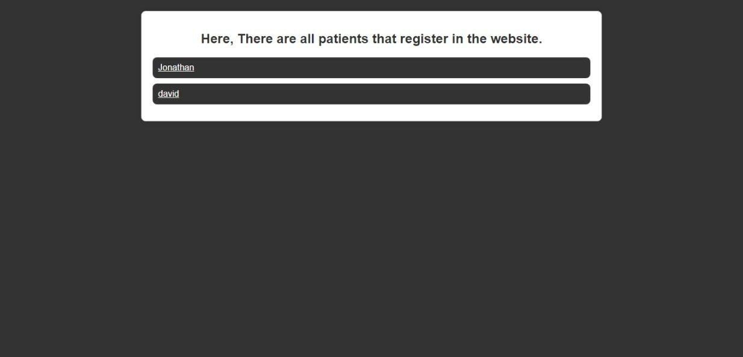
Doctor’s Diagnosis per Patient depending on his/her Status

Slide 54

Link model and make Api for website using flask
1
Create folder incudes the flask code and deep learning model To be uploaded local to the Flask server
2
When user upload image in website that sent a POST request to the URL
"http://127.0.0.1:5000/predict".
3
the Api will get photo and go to server of flask to get result by post request from server Django
4
it retrieves the response text from the server When the request is complete to display the predicted category at same page and save in user profile.
5
The response will appear to the user and will be recorded on the profile page so that the user and the doctor can view it

Slide 55

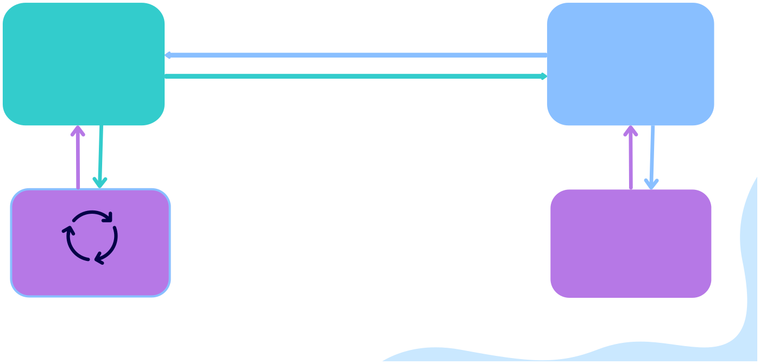
Architecture Overview
Flask
API
django
http://127.0.0.1:5000
http://127.0.0.1:8000/
Hosting Server
Hosting Server
user
Model Training
website

Slide 56
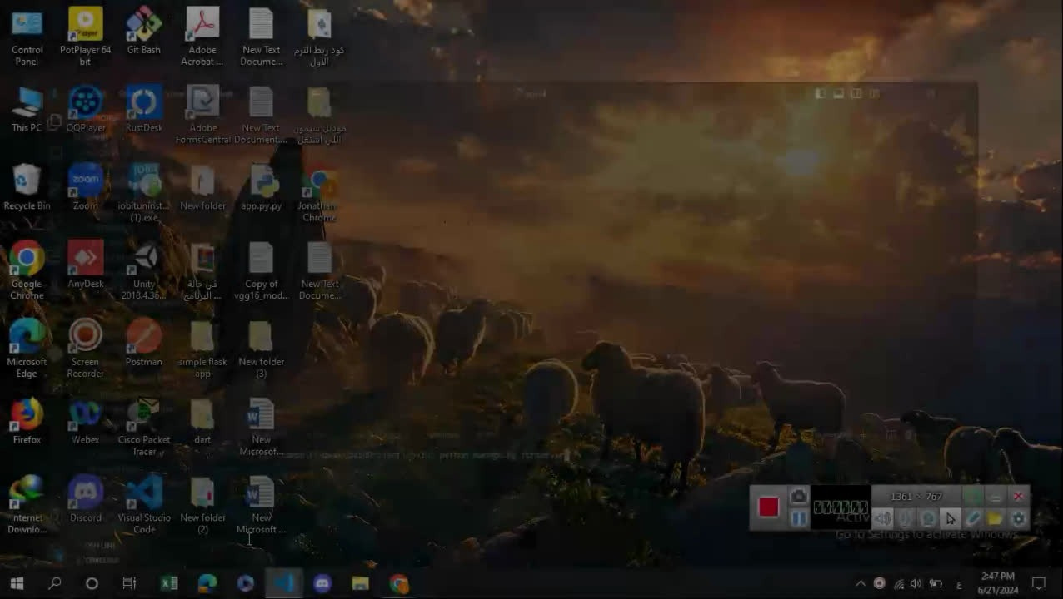
1.
Demonstrate implementation through video

Slide 57


09
Methodology

Slide 58
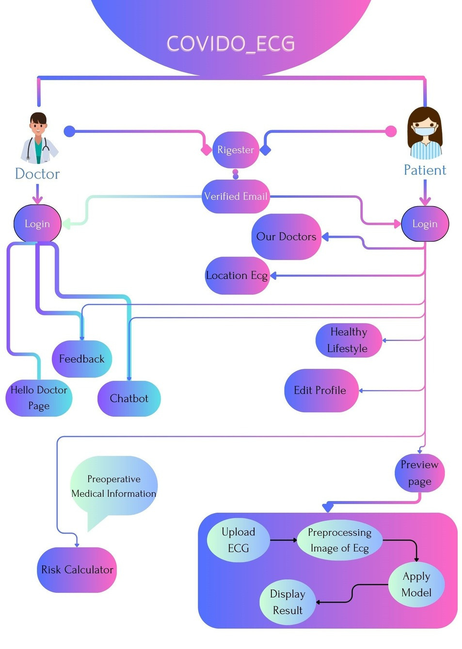

Structure of System

Slide 59
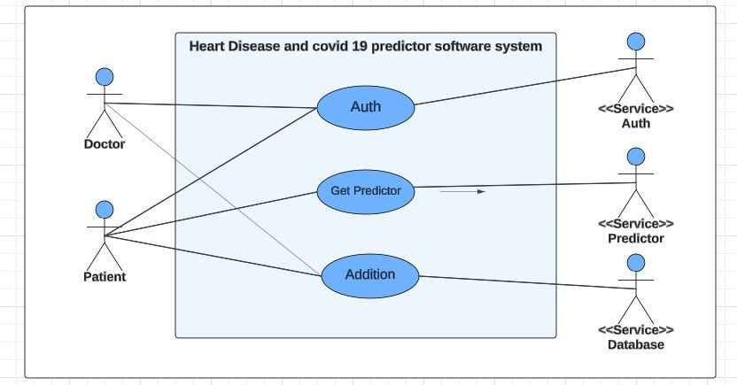
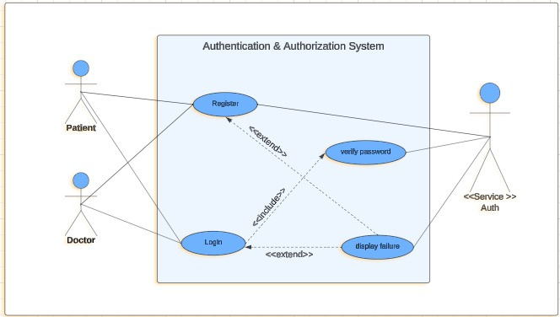




Use Case Scenarios

Slide 60

class diagram
sequence diagram

Slide 61


10
Technologies

Slide 62








FRONT
BACK END
AI

Slide 63

11
TIME PLAN

Slide 64

Time plan
2 weeks
Research and understand the idea of the project
2 weeks
Understanding the dataset
Data visualization
2 weeks
4 weeks
-Preprocessing for data and augmentation
-Create a web site and create database in MySQL
- Implementation and build the model.
- Link model and make Api for website.
4 weeks
4 weeks
- Improve accuracy - add new features to website
Obtain the final version of the project and to amend any proposals from the doctor and teacher assistant.
2 weeks

Slide 65


